Slide 1
Data visualization of labor market
To get a better job & hire talents!

Slide 2
Introduction of bubble chart
Design: x-axis represent salary/price level, y-axis for working time. Area of each bubble represent number of employees.

Slide 3
The best ways to observe bubble chart
Show each bubble individually, from 2008 to 2016. In order to show changes along time line.
Show all bubbles in one year
Let all of them move at the same time.

Slide 4
how we found the pattern 3 Hypotheses
For example, only logistic industry was moving left, other industries all have increasing salaries level, which may indicates that logistics industry is experiencing recessions.
A big jump of the blue bubble was observed during 2008 to 2009, when financial crisis happened. Quite reasonable observation.
Almost all of them except logistics were moving right after 2008, which may indicate that the economy was recovering generally.

Slide 5
Superiority of bubble chart
Bubble charts in our project give information in 4 dimensions.
Bubble chart is so compact and informational
Can stop at any time and chose any bubble you want to focus on. It gives people freedom to pick up information they need
Provides you with specific numbers
Advantages & Advantages

Slide 6
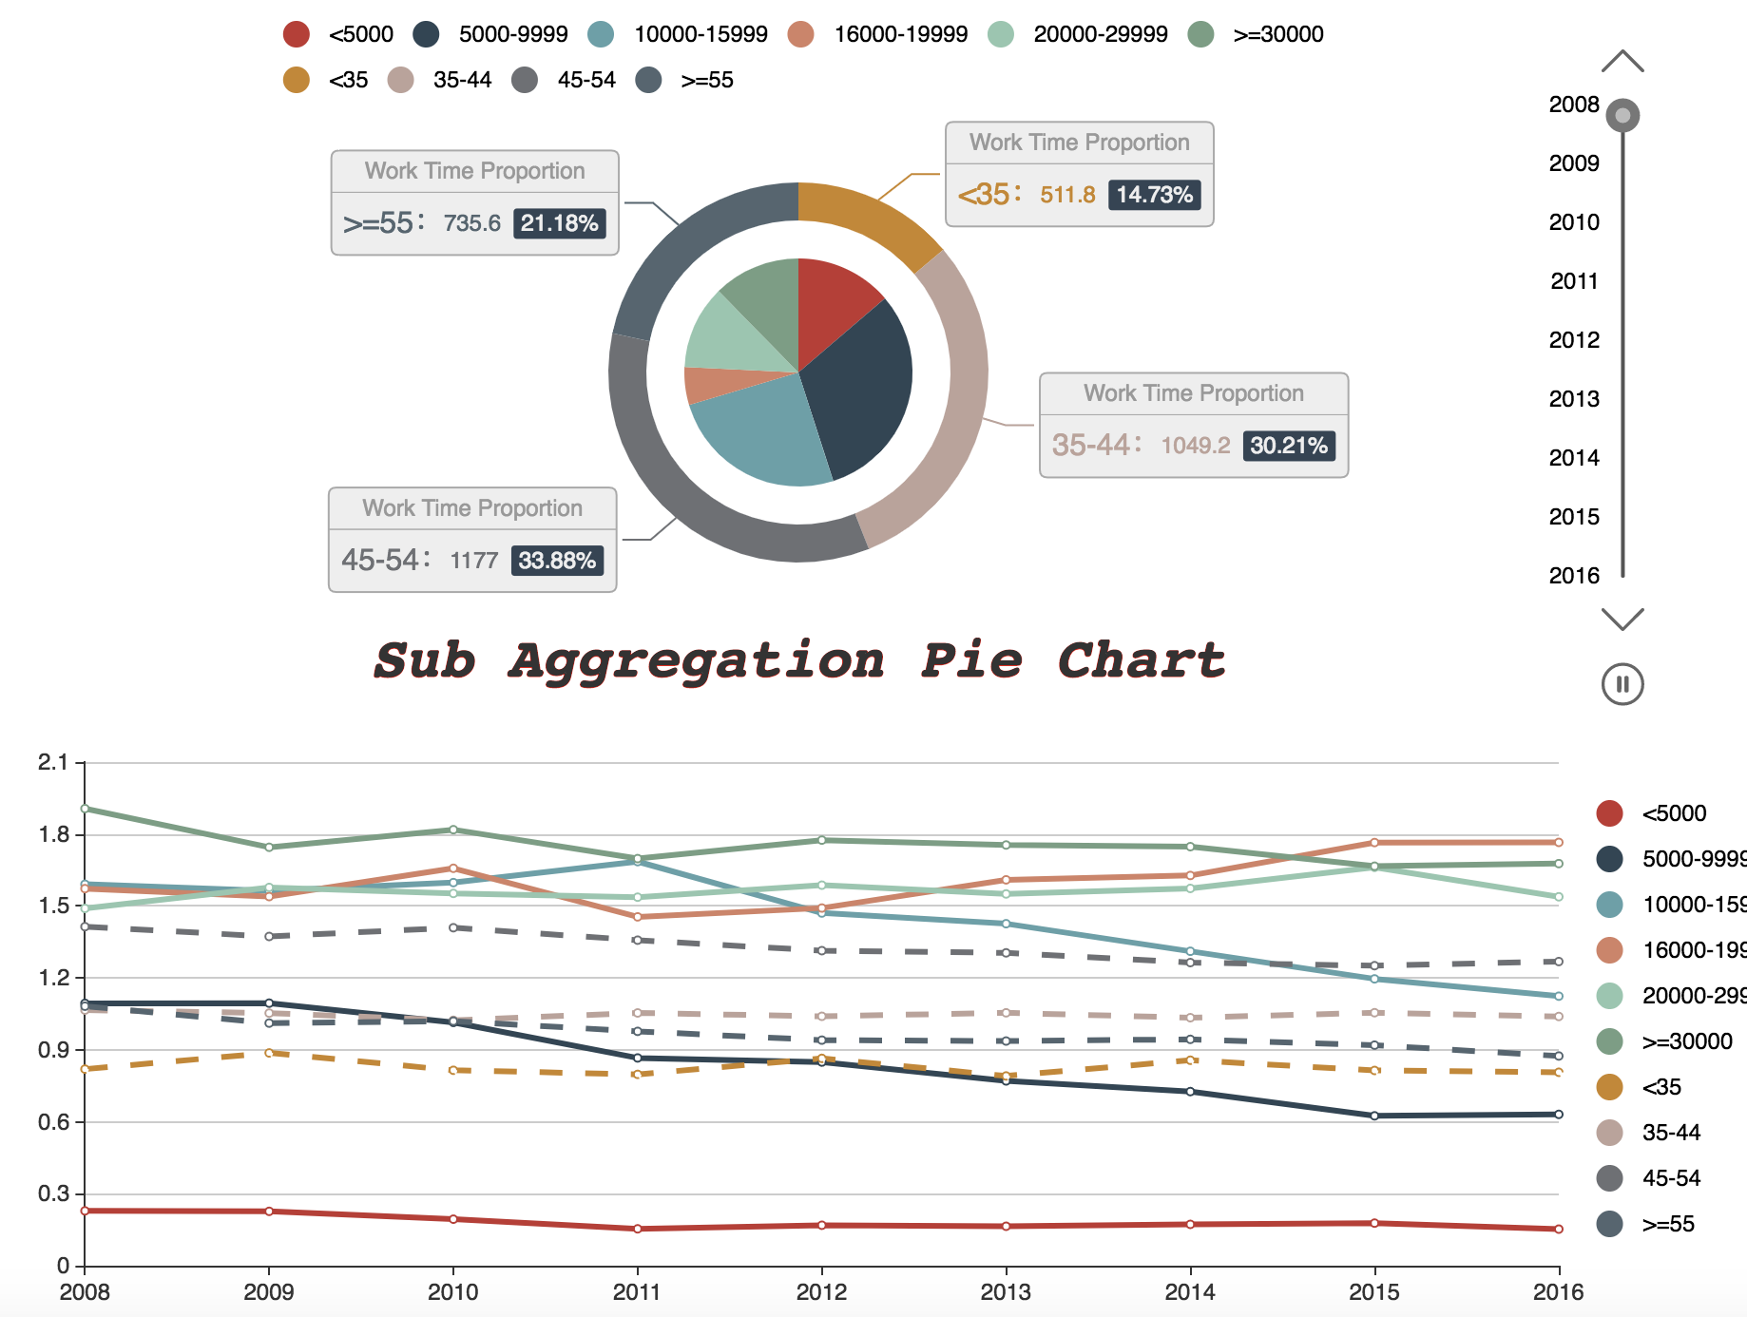
Sub aggregation Pie chart
Average working time per day is decreasing，but exceed 50% employees still working overtime in HK.
Monthly pay below 10k is decreasing，besides inflation, average salary is increasing
There is a big gap between the salaries of female and male. In the job market in Hong Kong in recent years, the proportion of females has risen below 15999 monthly pay

Slide 7
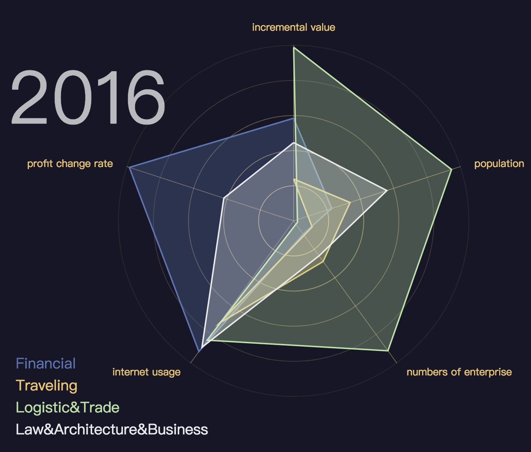
Radar chart
Finance in HK is still showing a strong trend
Traveling industry is facing transformation
Free trade transportation was affected by the changes from the mainland

Slide 8


INTEGRATED SKILLS

Slide 9
<html>
<head>
<meta charset="utf-8">
<title>sexual</title>
<!-- introduce echarts.js -->
<script src="path-echarts.js"></script>
</head>
<body>
<!—design a container for Echarts with a specific size-->
<div id="main" style="width: 1195px;height:640px;"></div>
<script type="text/javascript">
//initialize echarts based on the prepared container
var myChart = echarts.init(document.getElementById('main'));
option = {
baseOption: {
timeline: {
……//position, style setting and data of timeline
},
legend: {
……//position, style setting and data of legend
},
title: {
……//global setting of title (position, text, text style…)
},
tooltip: {
……//formatter, style setting of tooltip
},

Slide 10
xAxis: {
……//based setting of xAxis
},
YAxis: {
……//based setting of yAxis
},
series: [//based setting of item series
{
name: 'Financial',
type: 'scatter',
itemStyle: {
normal: {
shadowBlur: 10,
shadowColor: 'rgba(120, 36, 50, 0.5)',
shadowOffsetY: 5,//setting of shadow
color: new echarts.graphic.RadialGradient(0.4, 0.3, 1, [{
offset: 0,
color: 'rgb(251, 118, 123)'
}, {
offset: 1,
color: 'rgb(204, 46, 72)'
}])//setting of color
}
}
},
……
],
animationDurationUpdate: 1000,//animation setting (time interval, animation style)
……
},

Slide 11
options: [//specific setting of each item series
{
title:[{//text, position and text style of title
text: 2008,
textAlign: 'center',
left: '63%',
top: '25%',
textStyle: {
fontSize: 100,
color: 'rgba(255, 255, 255, 0.7)'
}
},
……
},
series:[//value and style setting of item series
{data: [
{
name:'Fianancial',
value:data.series[0][0]
}
],
type: 'scatter',
symbolSize: function(val) {
return sizeFunction(val[2]);
// var sizeFunction = function (x) {var y =Math.sqrt(x / 50);
return y;
};
}
},
……
},
//using the above option setting and data to display the graph
myChart.setOption(option);
</script>
</body>
</html>

Slide 12
Thank You！

